Slide 1
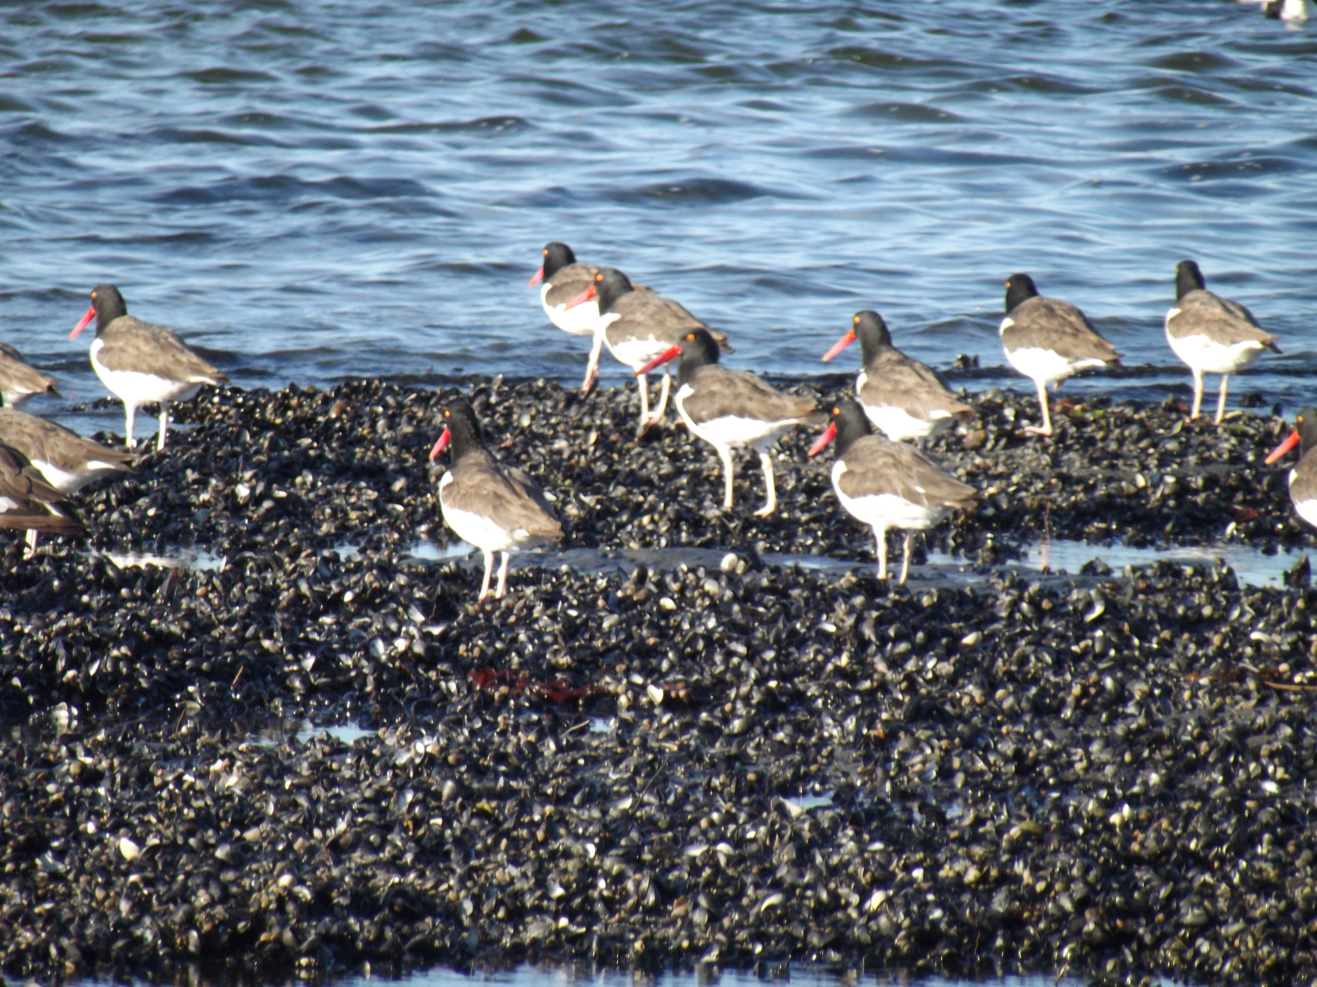
Population Genetics of Endangered Species
The Hardy-Weinberg equilibrium, small populations and environmental bottlenecks.

Slide 2
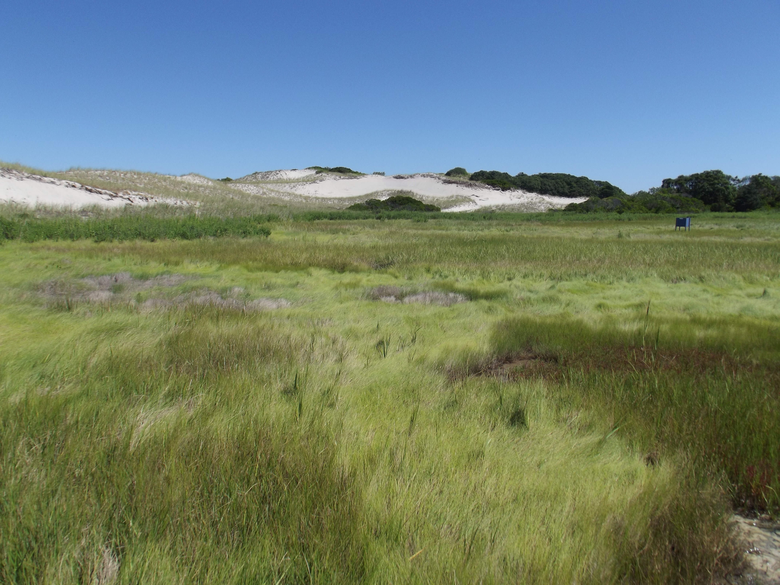
Excerpt from: On the Trail of the Eskimo Curlew
It wasn't supposed to be curlew weather- stifling hot, dead calm, sun glaring through opaque late summer humidity. And yet, just like that, there it was- a phantom, slipping from a wet swale into surrounding dune grass- just the kind of spot where a century earlier Yankee gunners might have sought it. It indeed seemed odd that it should slink away like some overhunted, over-persecuted game bird rather than like a typical shorebird that explodes into the air when approached. It was a medium-sized brown thing, mottled with white, with a longish beak and a striking splash of cinnamon buff visible as it moved off- a glimpse, to be sure, but the cottony buzz filling my head told me I believed I'd actually seen it. I had been searching for three years, not nearly long or hard enough, I had thought, but just the same there it was. Wasn't it?

Slide 3

Objectives
Understand the Hardy-Weinberg equilibrium and its assumptions.
Consider the genetic characteristics of small populations.
Examine the problems faced in the conservation of small populations.

Slide 4
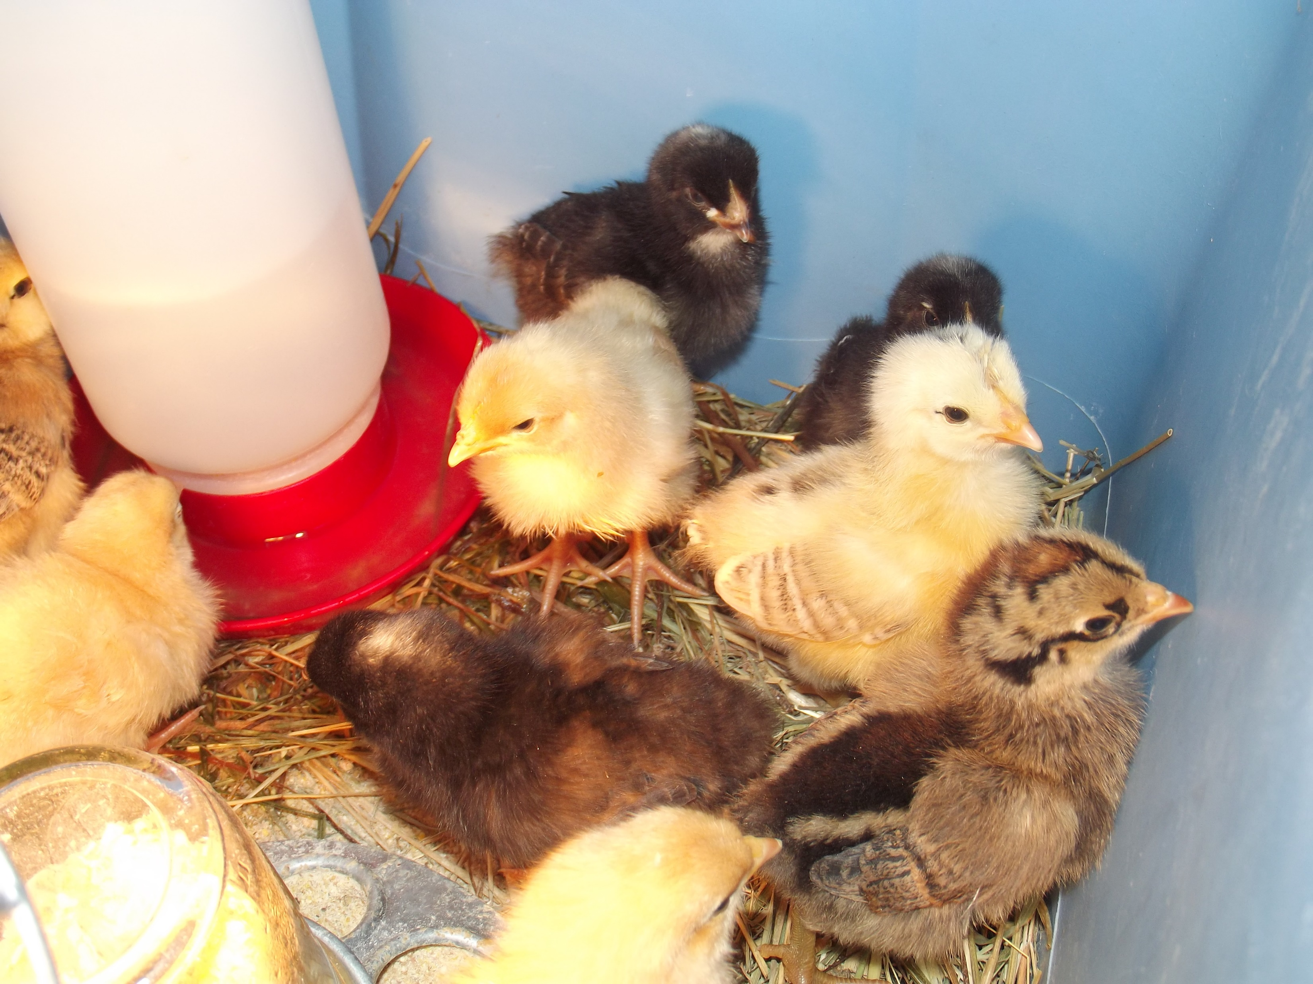
The Hardy-Weinberg Equilibrium
Early in the history of genetic studies, Hardy and Weinberg independently recognized that in a large, randomly mating population, gene frequencies remained the same in the absence of disturbance.
In its simplest form for a single gene locus, consider alleles A and a occurring with equal frequency in a population:
  The predicted frequencies of occurrence of gene A (p) + that for gene a (q) in a population is 1: 0.5 + 0.5 = 1, or (p + q) = 1.
  When crossing two homozygous individuals (the f₀ generation), the expected genotype proportions of the f₁ generation are (p + q) x (p + q), or (p + q)² = 1.
  A binomial expansion yields f₁ = p² + 2pq + q² = 1. Alleles A and a will produce offspring genotypes of 0.25 AA, 0.50 Aa and 0.25 aa from a cross of purebred parents, or 0.5 A and 0.5 a. Hence, the frequencies of the two alleles have not changed from one generation to the next.
Selection has produced different breeds from the same original gene pool.

Slide 5
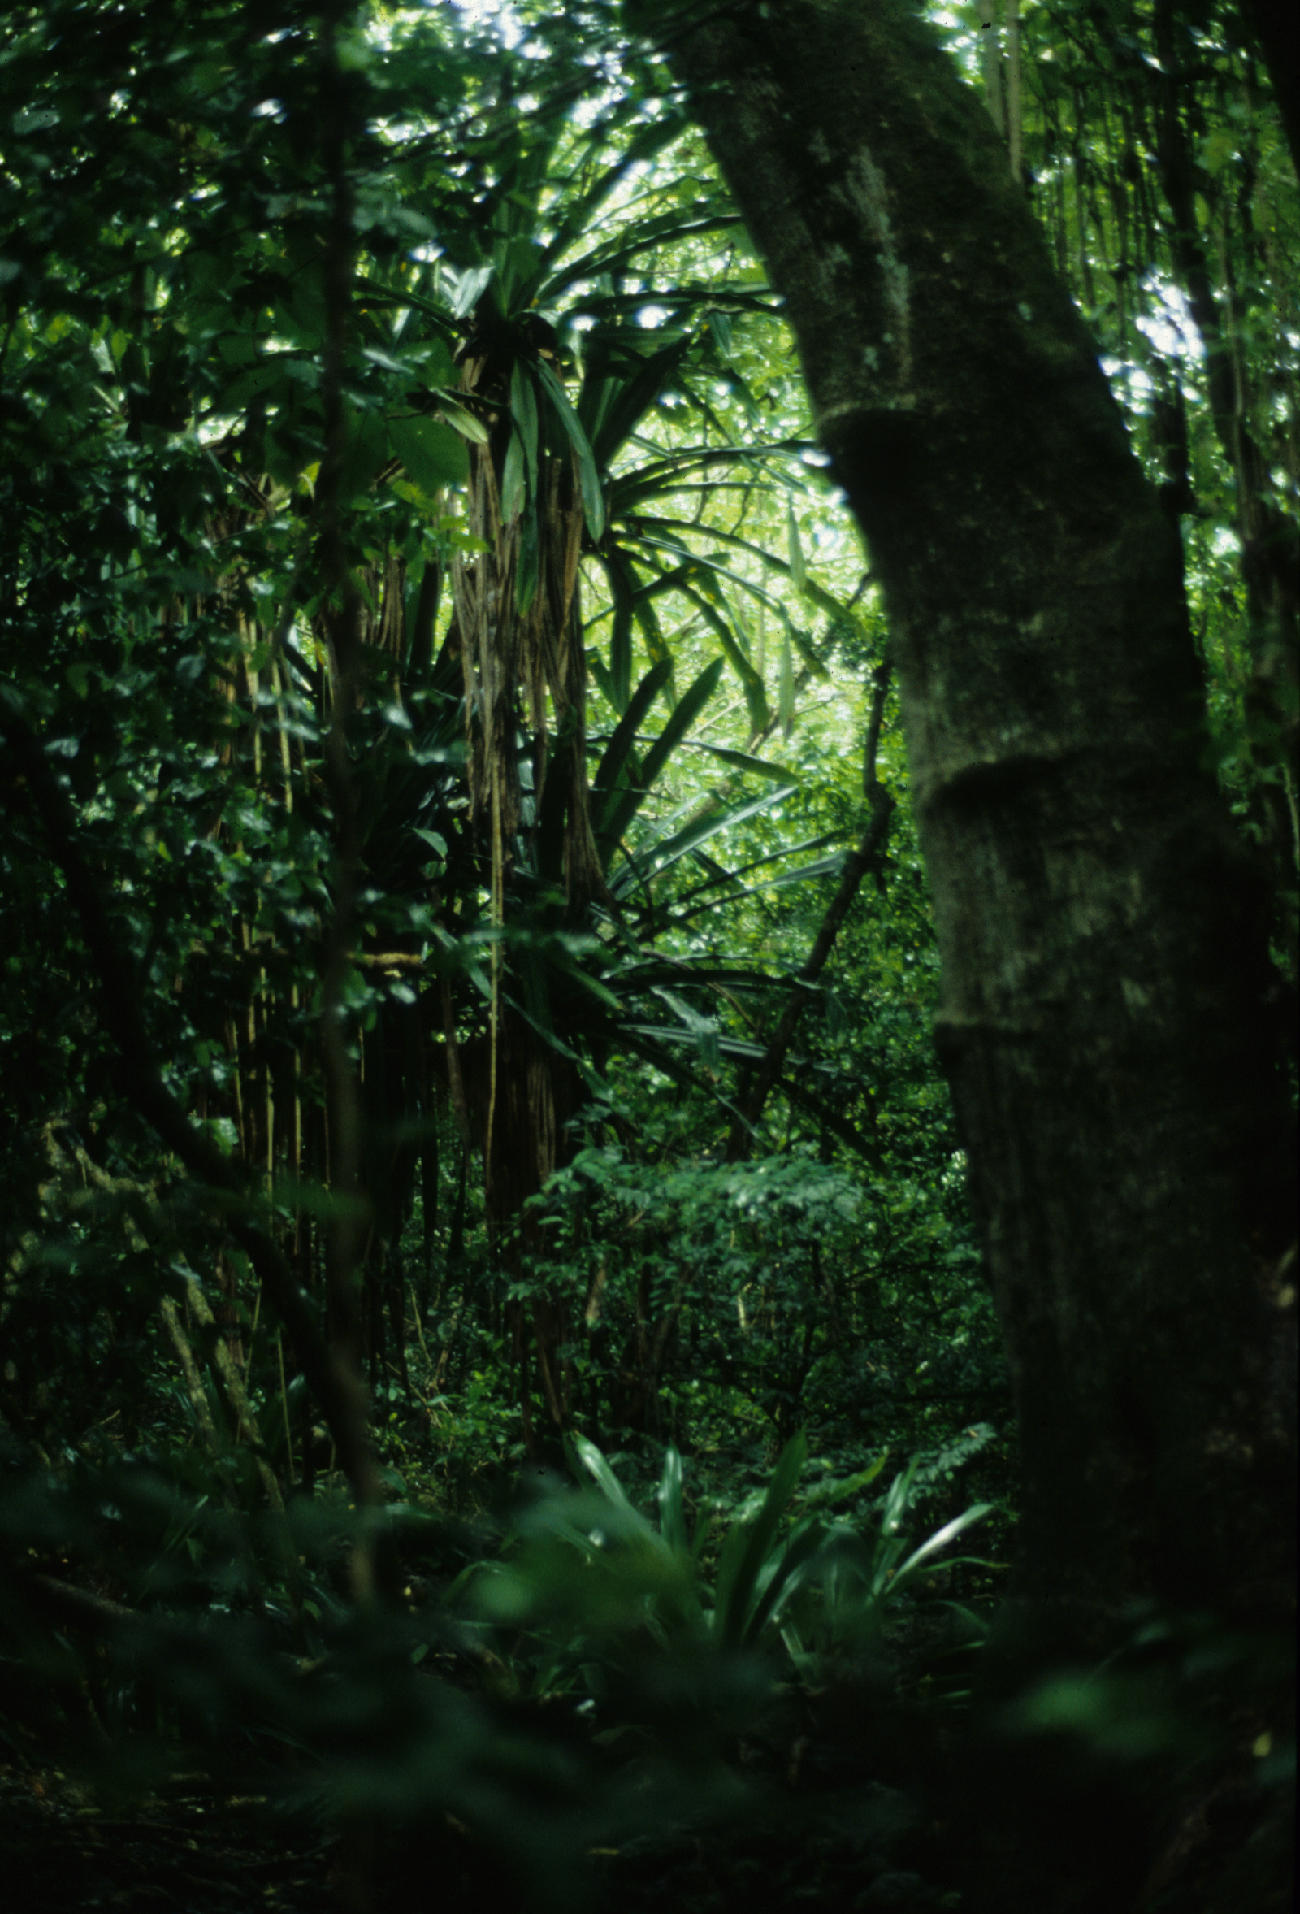
Assumptions of Hardy-Weinberg
Hardy-Weinberg further assumes that populations are:
  Monoecious and diploid with random mating.
  There is no disturbance to gene frequencies, such as through natural selection, sexual selection, mutation, assortive mating, founder effect, genetic drift and population bottlenecks.
Although this model is a reasonable first approximation to short-term population genetics, it has numerous limitations, such as:
  Many plants, particularly groups like gymnosperms, are dioecious; many are also triploid to polyploid. Moreover, many reproduce by methods other than sexual ones, such as via rhizomes and runners.
  Even more primitive vertebrates like amphibians routinely reproduce asexually (parthenogenesis) and interspecific hybrids may act as full species.
  Mutation and natural selection act on all populations, the effects of which are plainly evident from the fossil record. Their effects are detectable even over a short series of generations, as demonstrated by studies of directional selection on Darwin’s Finches.
Hence, there are multiple routes for species not to follow the Hardy-Weinberg model, and these may lead to conservation concern.
Pisonia grandis (right) reproduces primarily asexually. After typhoons, fallen branches root on the forest floor.

Slide 6
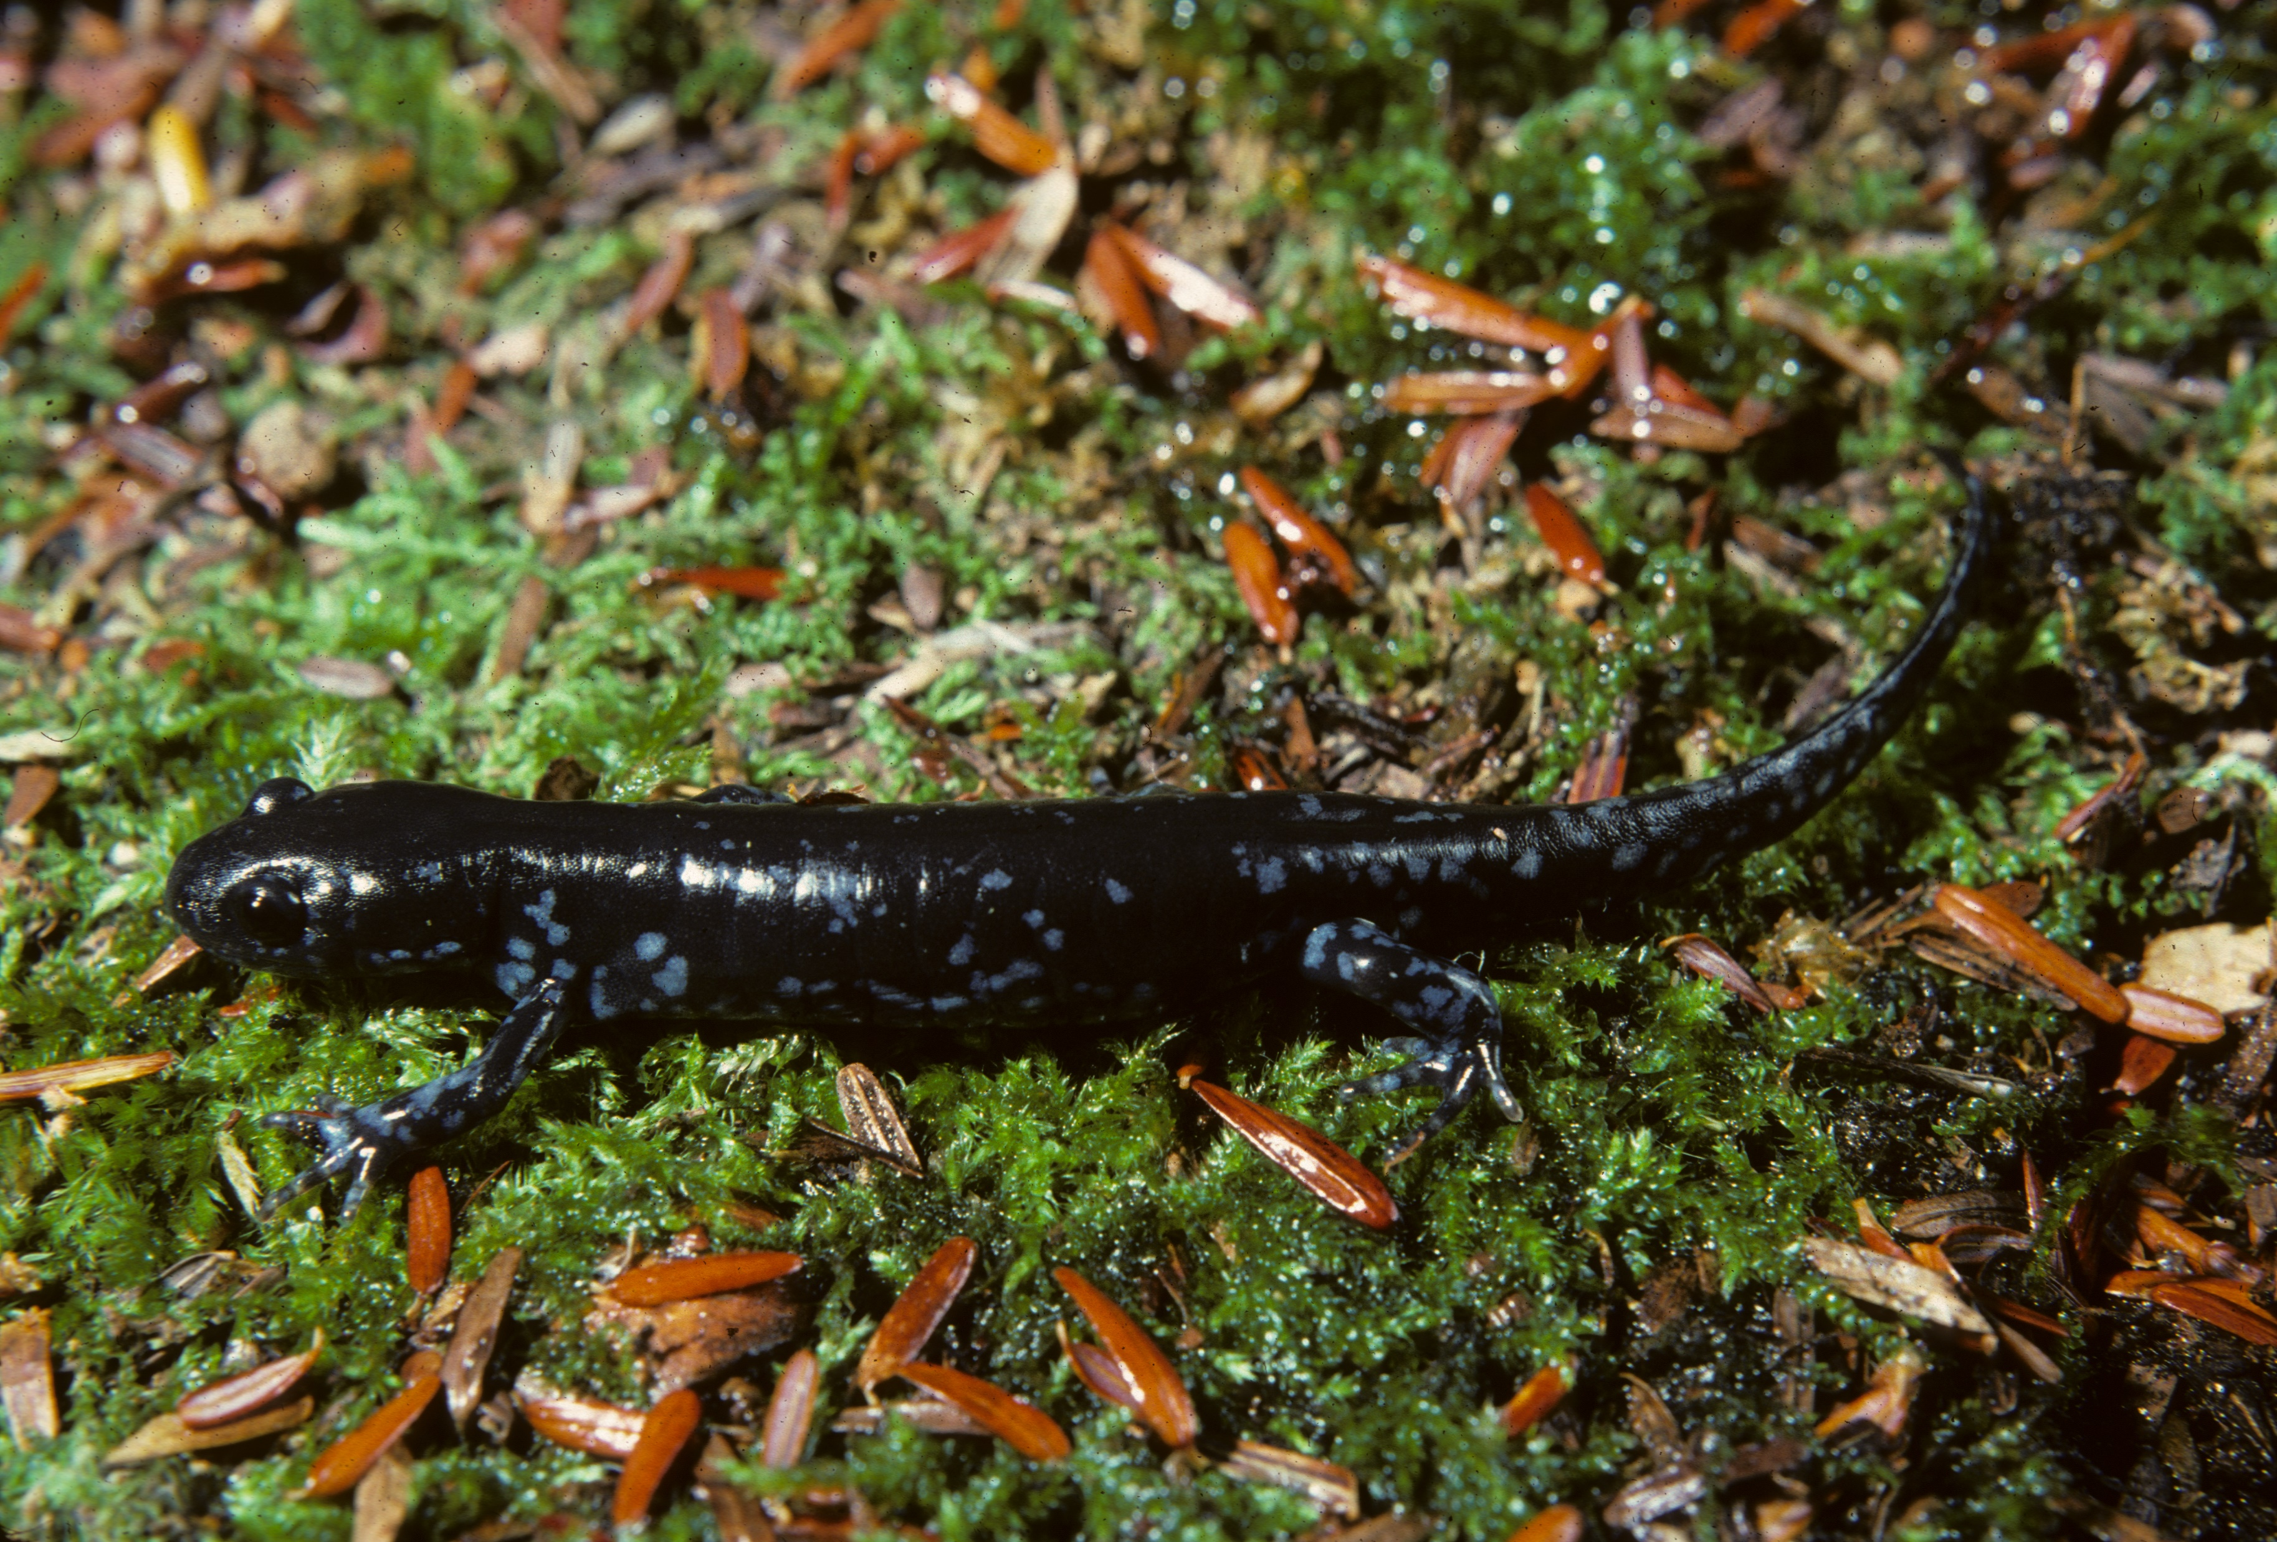
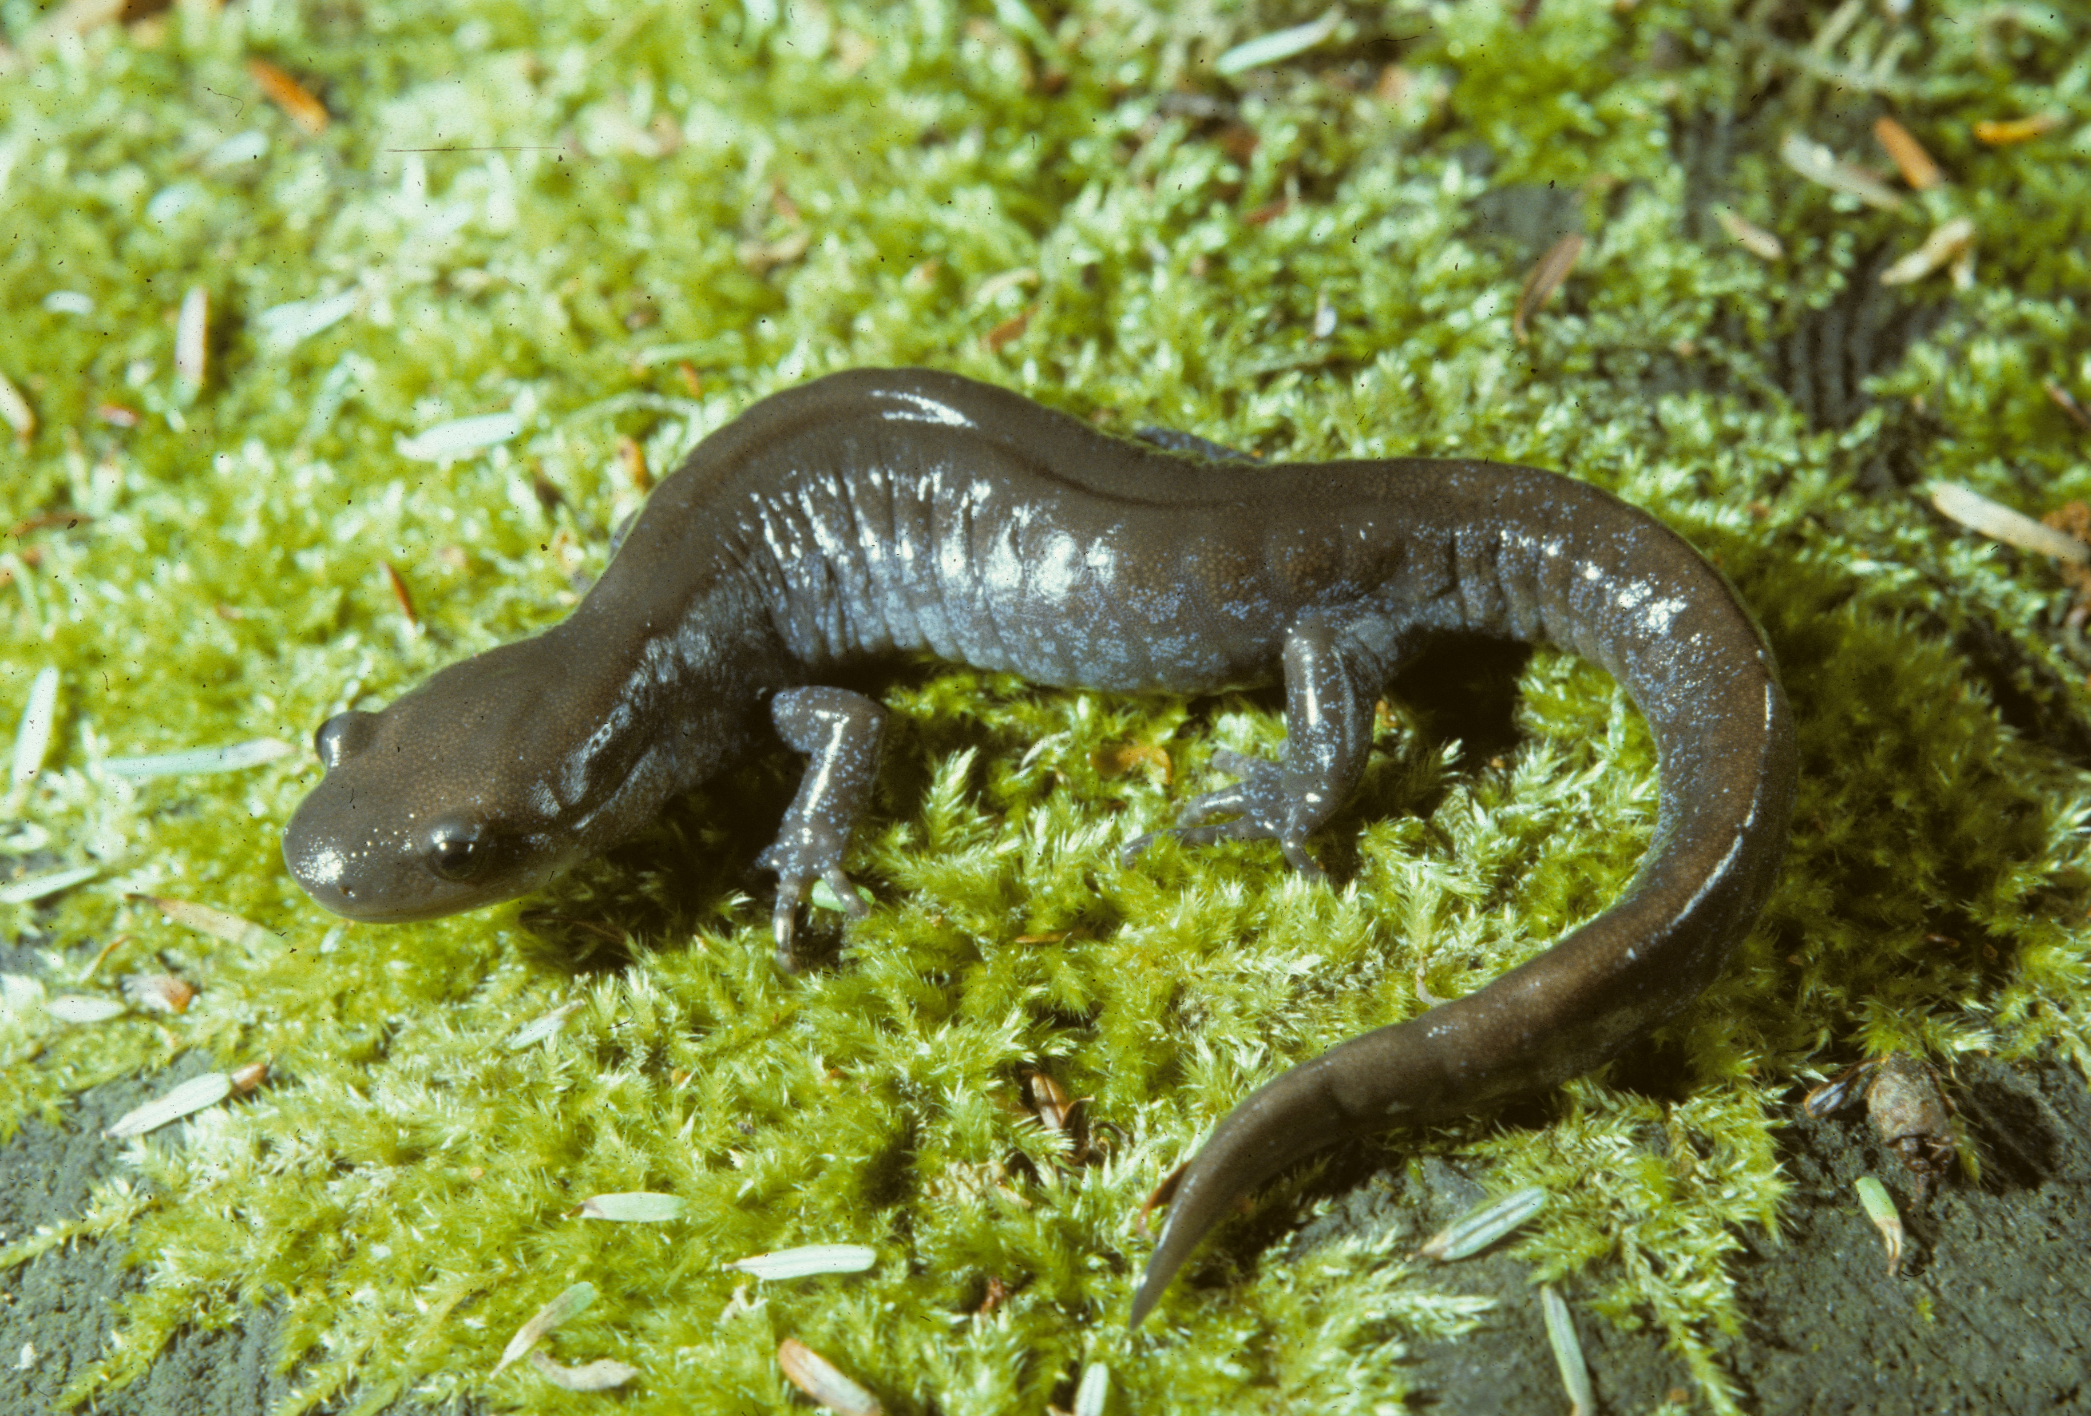
Hybrid Species
The Blue-spotted Salamander (right) and Jefferson’s Salamander (below) are related diploid species.
They have spotty distributions in southern New England and elsewhere, where they can be uncommon to rare.
Where their distributions overlap, they hybridize.
The Silvery and Tremblay’s Salamanders are hybrid triploid female forms derived from these species that function as species.
Males of the parent species stimulate egg development in these forms without contributing genetic material.
Should such forms be considered of conservation concern in regions where they are rare?

Slide 7
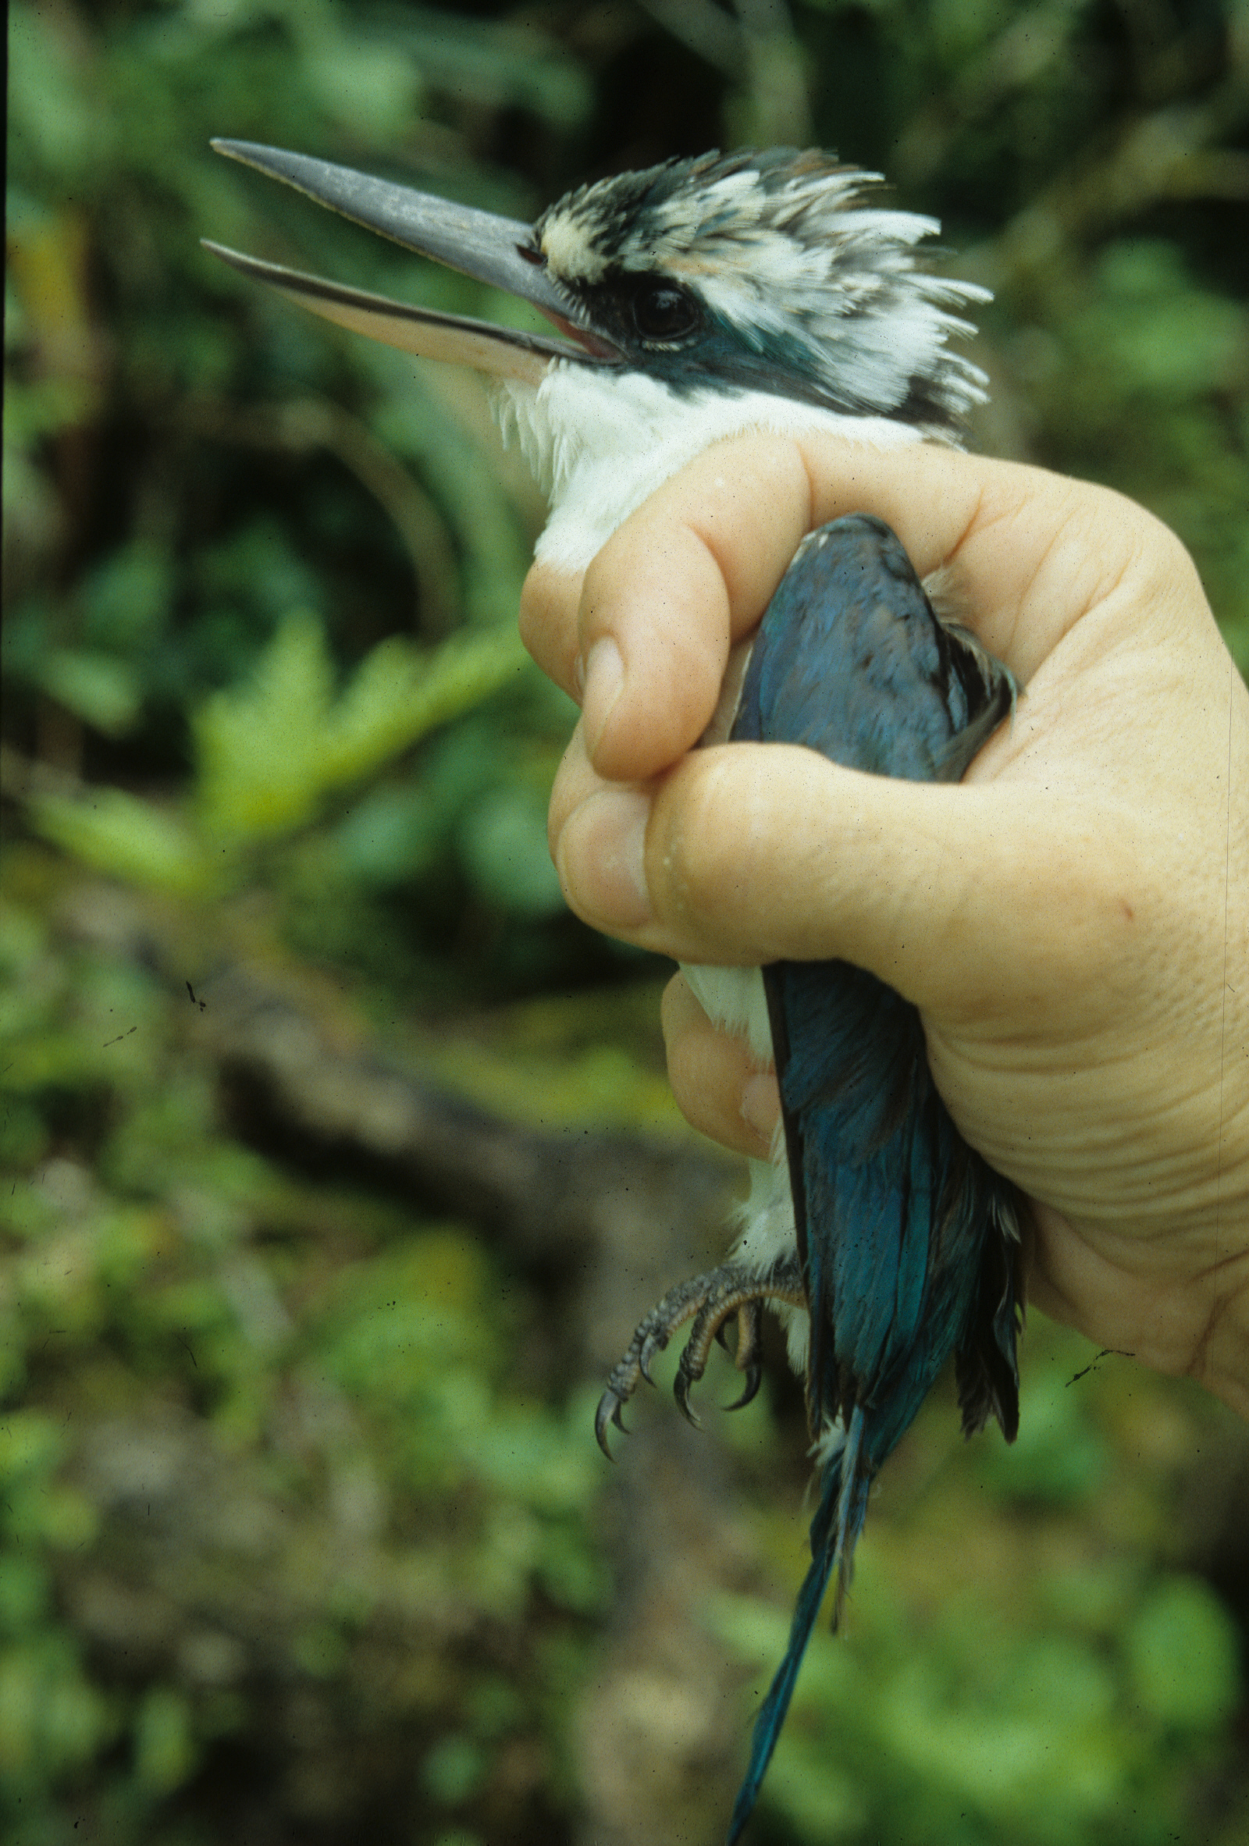
Genetics of Small Populations
Genetic diversity provides the raw material for adaptation to environmental change. As environments change, natural selection favors individuals with adaptive traits.
When a population becomes small and isolated, the Hardy-Weinberg equilibrium breaks down. Gene flow is limited and genetic diversity can drop by certain alleles becoming fixed. Moreover, genetic drift becomes more likely, exacerbating genetic erosion.
Inbreeding increases, leading to greater homozygosity among traits, which can expose deleterious mutations. In plants that outcross, depression in rates of seed production follows from selfing.
Hence, small populations are less well-suited to tolerate environmental change and fitness (contribution of genes to the next generation) typically drops.
However, individual small populations have been found to contain different segments of a rare species’ total genetic compliment, so preservation of multiple small populations can be critical to a comprehensive conservation plan.
Founder Collared Kingfishers on the Pacific island of Rota possessed only a portion of the species’ gene pool, and the blue crown trait became fixed in the population.

Slide 8
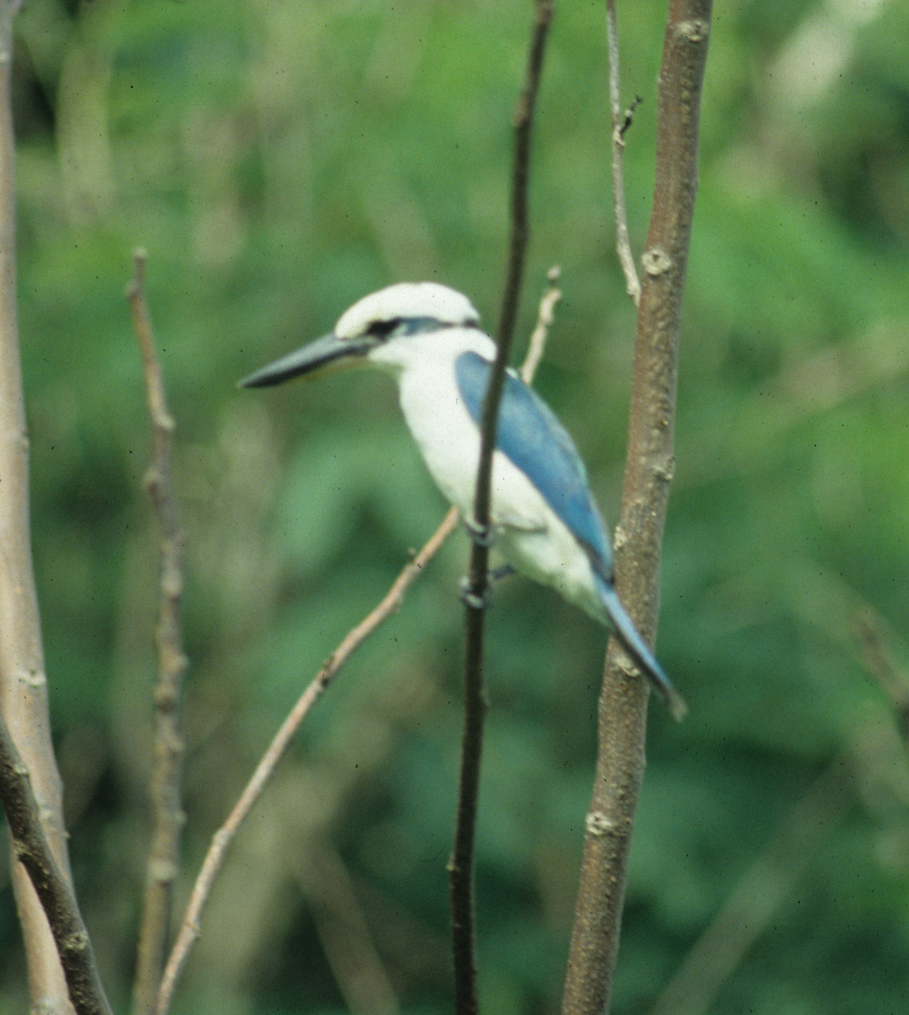
Population Bottlenecks
When species experience some catastrophic environmental event like wholesale habitat loss or climatic change, its populations may decline to the point where small population phenomena take effect.
Because genetic diversity is regained only slowly by mutation rates, such species may then experience inbreeding depression.
A number of species exhibit genetics that indicate they have passed through bottlenecks. Measures of allele diversity in them are typically low compared with those of widespread and common species.
All European Bison, for example, are descended from 12 individuals and exhibit inbreeding depression.
Other populations of the widespread Collared Kingfisher have white crowns.

Slide 9
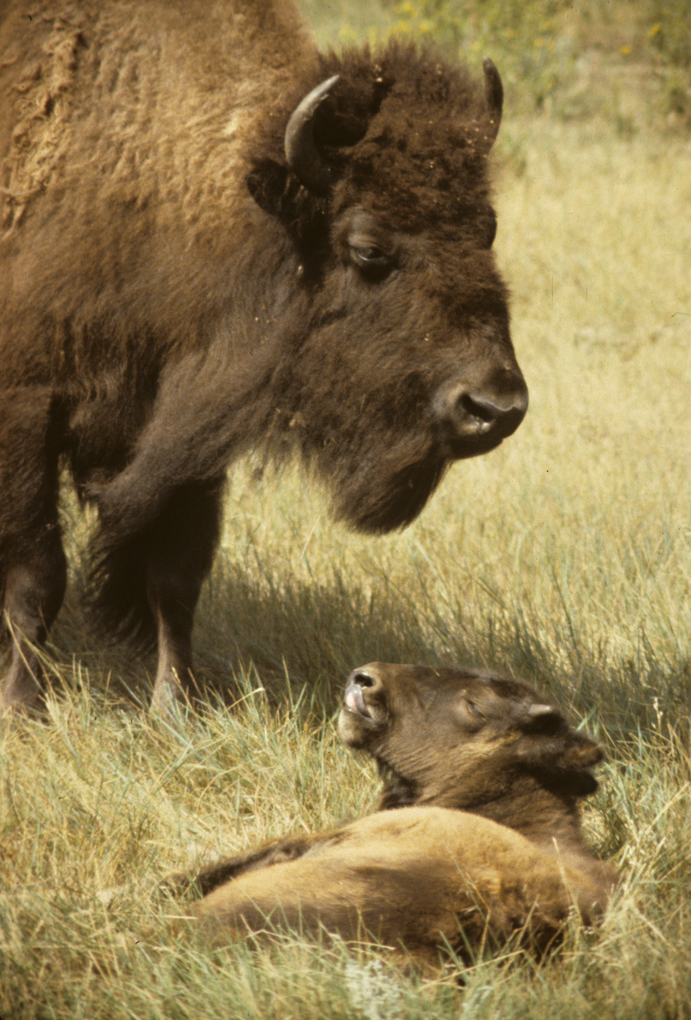
Case Study: Conservation Genetics of American Bison
Like the European Bison, the American Bison was reduced from a population of tens of millions to a few individuals during the 19th century via hunting and wholesale habitat destruction.
All members of the Plains Bison subspecies are descended from under 100 individuals; all Wood Bison descend from about 200 individuals.
As a consequence of passing through this population bottleneck, only a portion of the original gene pool still persists.
Moreover, due to ranchers crossing bison with domestic cattle, there are now cattle genes in most bison herds.
Furthermore, ranchers also selected for docile individuals with certain physical traits that benefitted livestock breeders. Such traits as these reduce the fitness of the wild populations, however.
Inbreeding depression has appeared particularly in herds derived from few individuals.

Slide 10
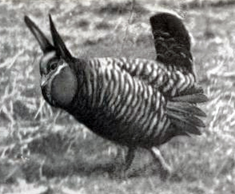
Case Study: Heath Hen
The Heath Hen appears to have evolved rapidly from a prairie chicken ancestor beginning about 21,000 years ago. At this time, glaciation resulted in grasslands extending to the middle Atlantic region and merging with extensive scrublands covering the Atlantic coast.
Because of its rapid evolution, it is likely that the gene pool exhibited limited variation.
DNA studies suggest that this eastern form was a distinct species. Behavioral data supports this, as it inhabited scrubland/ grassland mosaics rather than solely grasslands like other prairie chickens.
It was common along the East coast into colonial times, but experienced a population bottleneck by the mid-19th century due to unregulated hunting and habitat destruction.
A courting male Heath Hen on Martha’s Vineyard, Massachusetts, ca. 1900, showing strong feather barring.

Slide 11
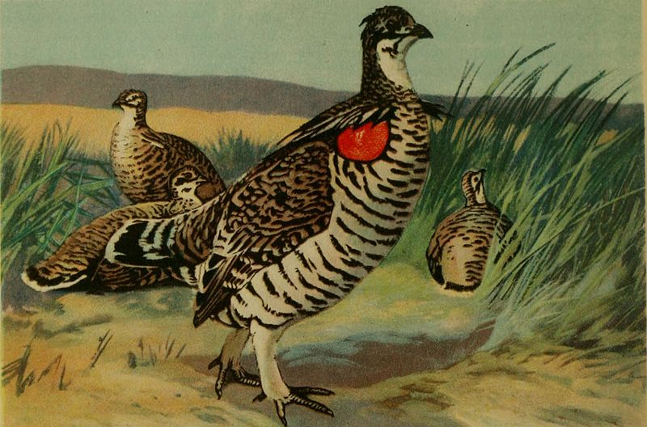
Heath Hen-continued
By this time, the mainland population was extirpated and only an island population persisted on Martha’s Vineyard, Massachusetts.
There were only 70 estimated in the late 19th century, but with protection numbers grew to 2000 by the 1910s, and attempts were made to re-establish birds into similar habitat on eastern Long Island. These efforts failed, however.
The decline that followed illustrated the role of multiple stochastic events, separate from initial causes, in sealing the fate of the species.
A wildfire in 1916 eliminated most of the population, particularly females. The species had evolved in a fire-prone landscape, but fire suppression made this wildfire more catastrophic than it otherwise would have been.
The population rebounded to 600 by 1920, but it then began a final decline.
The likely ancestral species, the Greater Prairie Chicken, showing its less distinct feather barring.

Slide 12
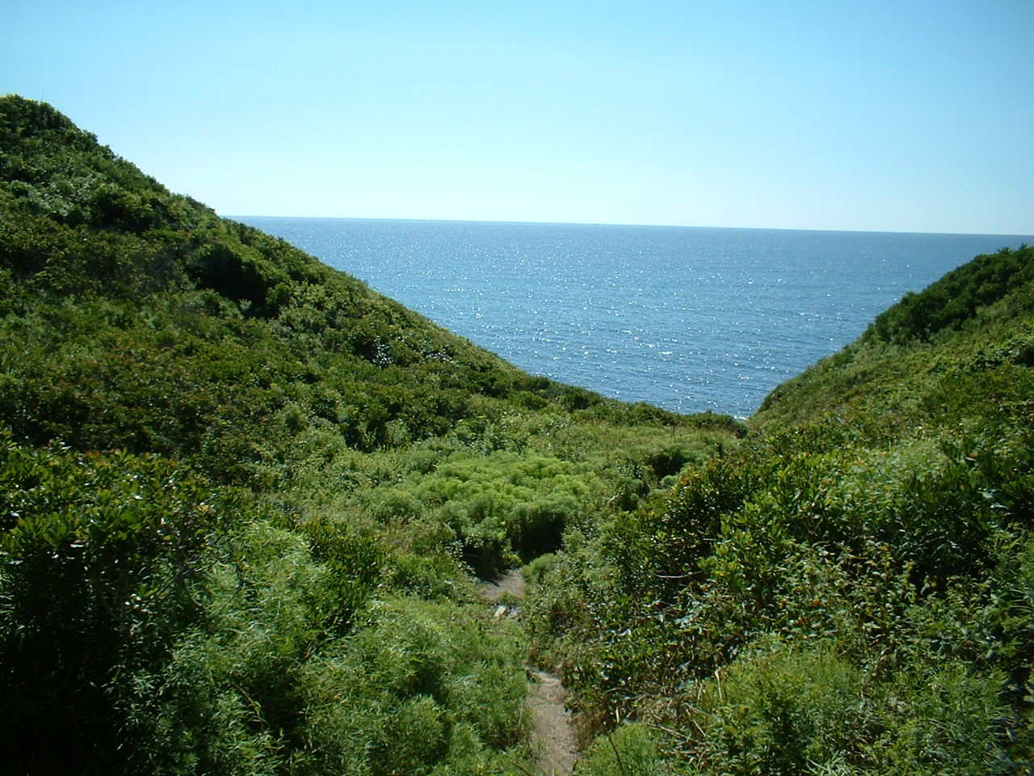
Heath Hen- continued
The skewed sex ratio reduced fecundity and the multiple bottlenecks the species passed through further reduced an already limited gene pool.
Inbreeding depression appeared to set in, such that little further reproduction occurred.
By 1928, one male remained, which was last seen in 1932.
Although multiple attempts at introducing Greater Prairie Chickens into the East have been made so that they might act as an umbrella species, these attempts have been unsuccessful. This species is ecologically distinct from the Heath Hen and East coast habitats proved unsuitable.
Attempts at re-assembling the genome of the Heath Hen are now underway, with plans being made to re-establish birds into their native range.
Coastal scrub, such as this on Block Island, Rhode Island, represents the original habitat of the Heath Hen.

Slide 13
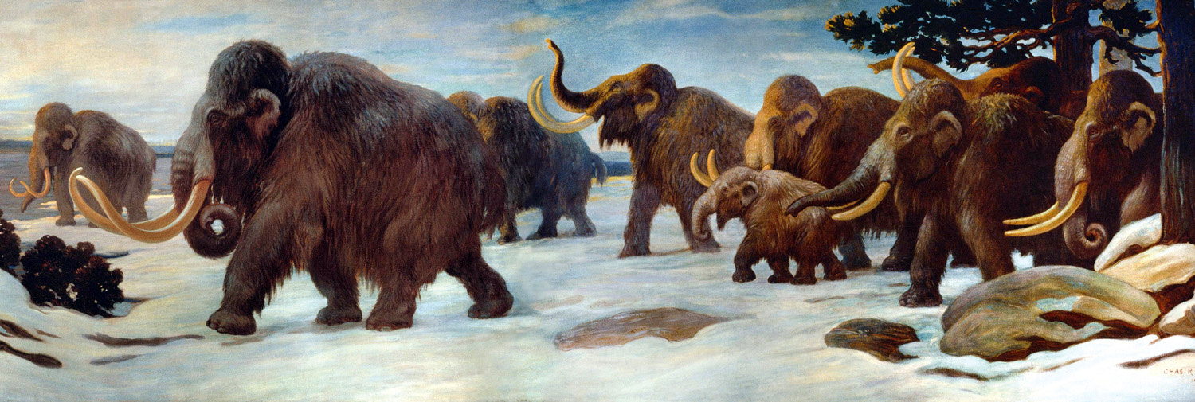
The Woolly Mammoth
The Woolly Mammoth became extinct throughout most of its range at the close of glacial times, about 10,000 years ago.
However, one population survived on isolated Wrangel Island off the north coast of Siberia, where a stable population estimated at 500-1,000 survived.
Genetic diversity of the species is documented to have dropped 30% during the late Pleistocene, but it stabilized in the Wrangel Island population, which persisted for 6,000 years and did not become extinct until 3,600 years ago.
The population disappeared shortly after human arrival, suggesting that hunting was related to its disappearance, although climate and, thus, habitat change likely contributed.
The persistence of this small population provides evidence that it overcame inbreeding depression and that this population size was sufficient for long-term viability.

